Slide 1

Intelligent Systems in Gaming
Presented by Michael Kiss

Slide 2

What is an Intelligent System?
Intelligent system - technologically advanced machines that perceive and respond to the world around them

Slide 3

Traffic Lights
Notes:
sensors in traffic control systems are used to detect the presence of vehicles at specific points. Sensors can be used to measure and monitor the number of vehicles that pass through a specific point, the speed at which the vehicles are traveling, and more. Sensors are used for a variety of traffic control and monitoring situations, including controlling traffic signals, freeway management, ramp metering, toll road monitoring, and more.
Infrared Sensors
Microwave Sensors
Video Sensors

Slide 4
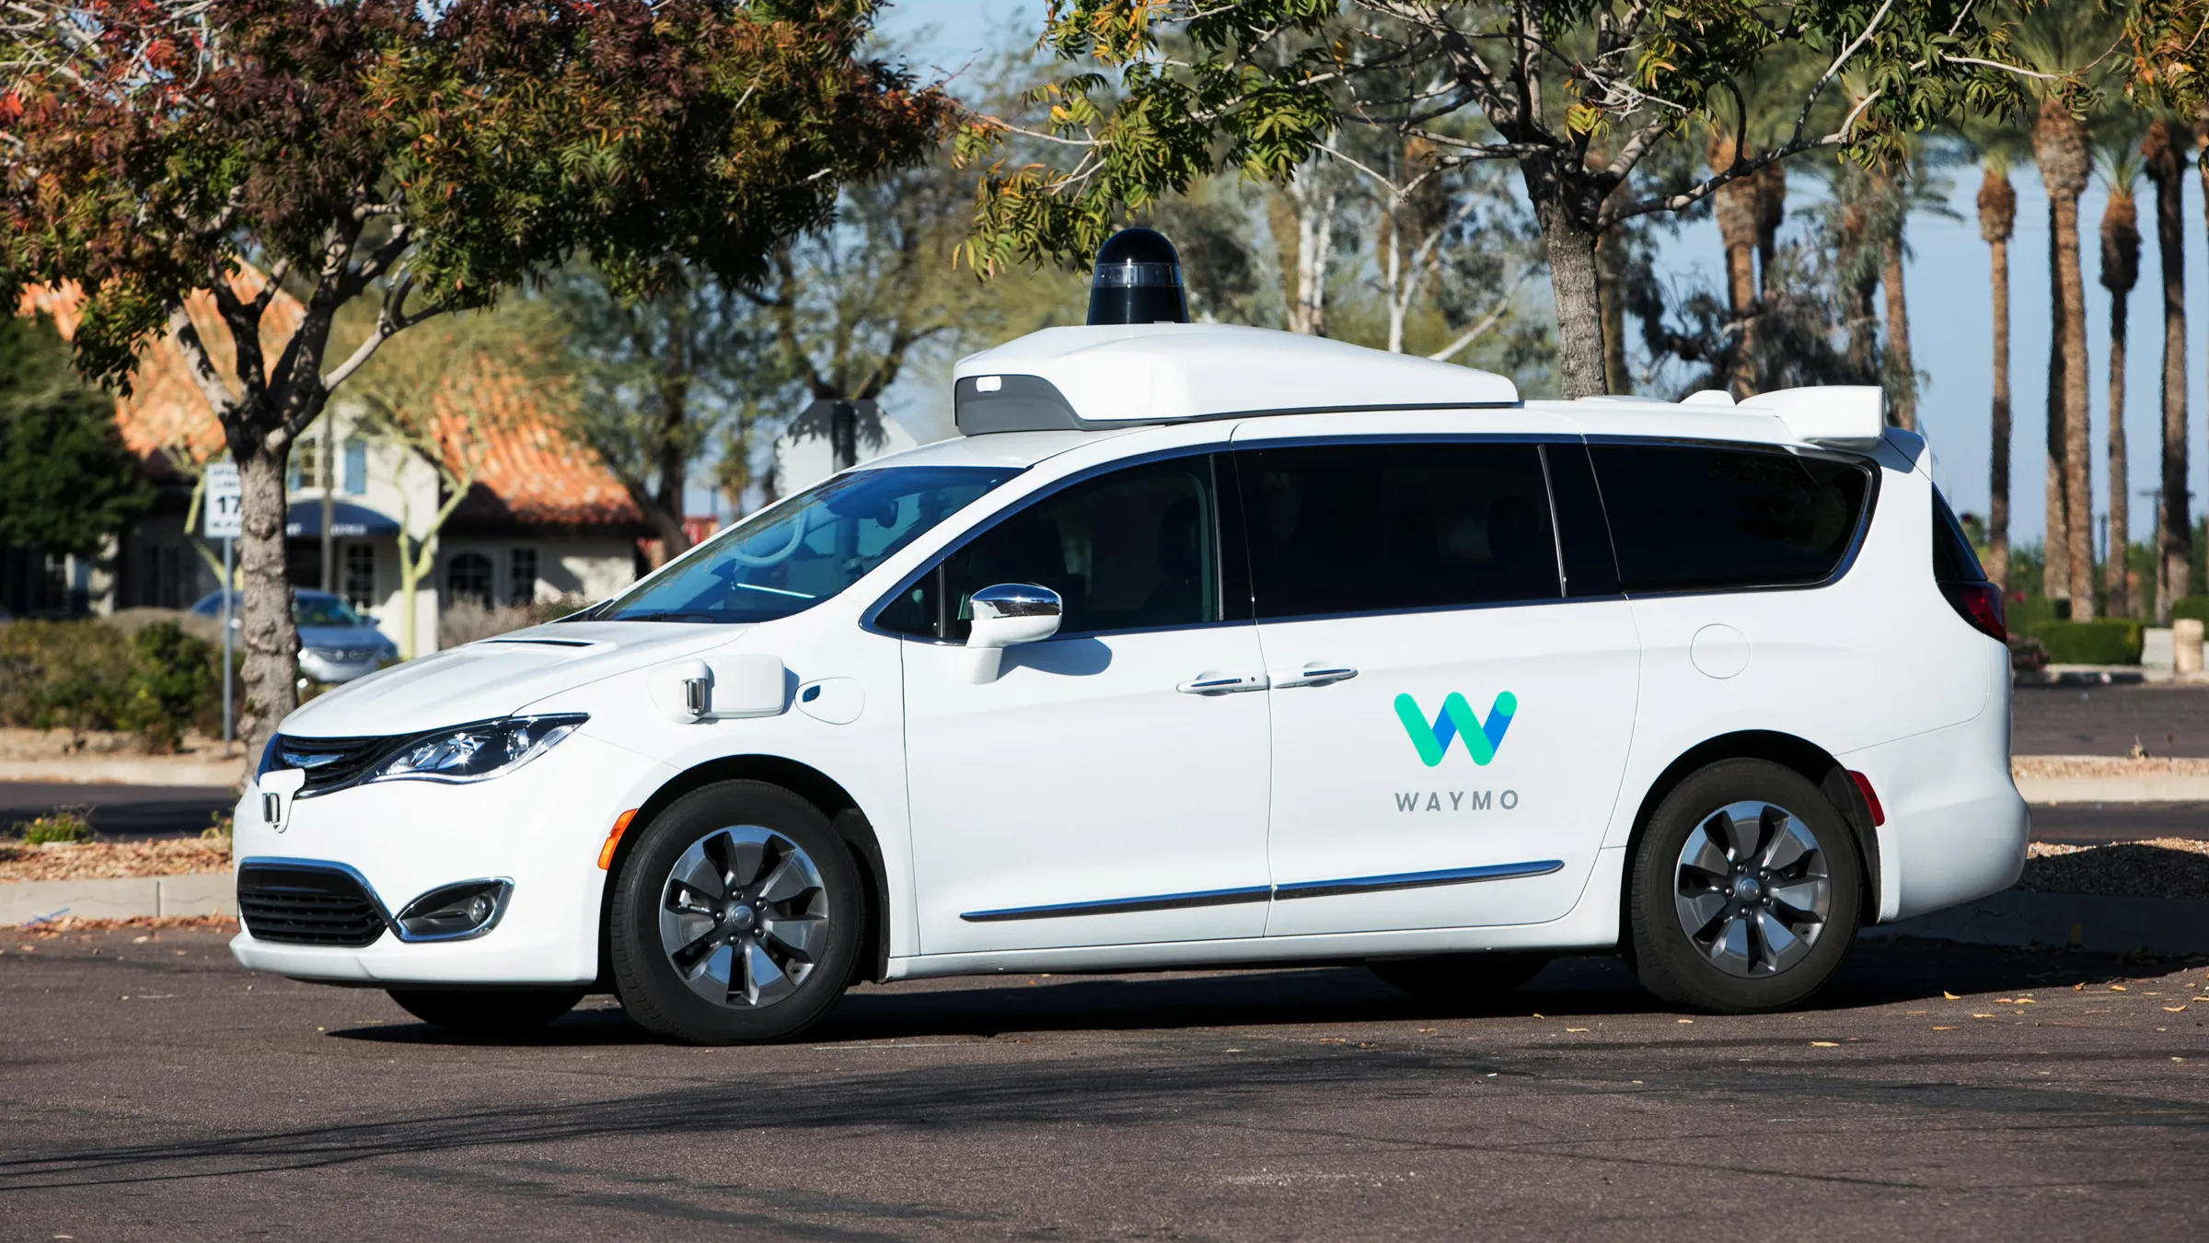
Autonomous Vehicles
Notes:
These cars use Lidar, Radar, camera, and ultrasonic sensors to perceive to world around them. This data is sent to a computer that plots a path, and sends instructions to the vehicle which control acceleration, braking, and steering.
Hard-coded rules Like if object Infront don’t accelerate. , obstacle avoidance algorithms, predictive modeling, and object recognition

Slide 5
List of Intelligent Systems Examples
POS Terminals
Digital Televisions
Smart Parking Meters
Automobiles
Airplane controls
Security Gates
NJIT Canvas
Video Games
Smart Phones
Vital Monitors
Factory automation
Notes:
There are way more systems than what I can name. But some examples and industries include. Point-of-sale (POS) terminals, digital televisions, traffic lights, smart meters, automobiles, digital signage and airplane controls

Slide 6

What are Video Games
Notes:
a game played by electronically manipulating images produced by a computer program on a television screen or other display screen

Slide 7
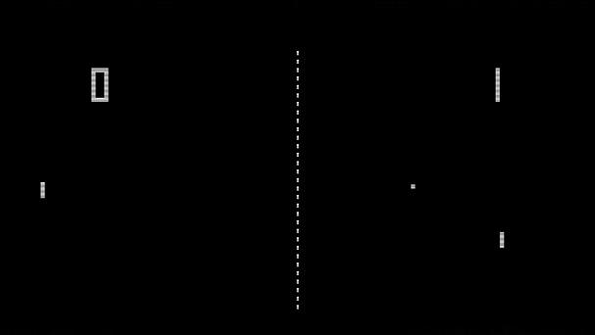
PONG

Slide 8
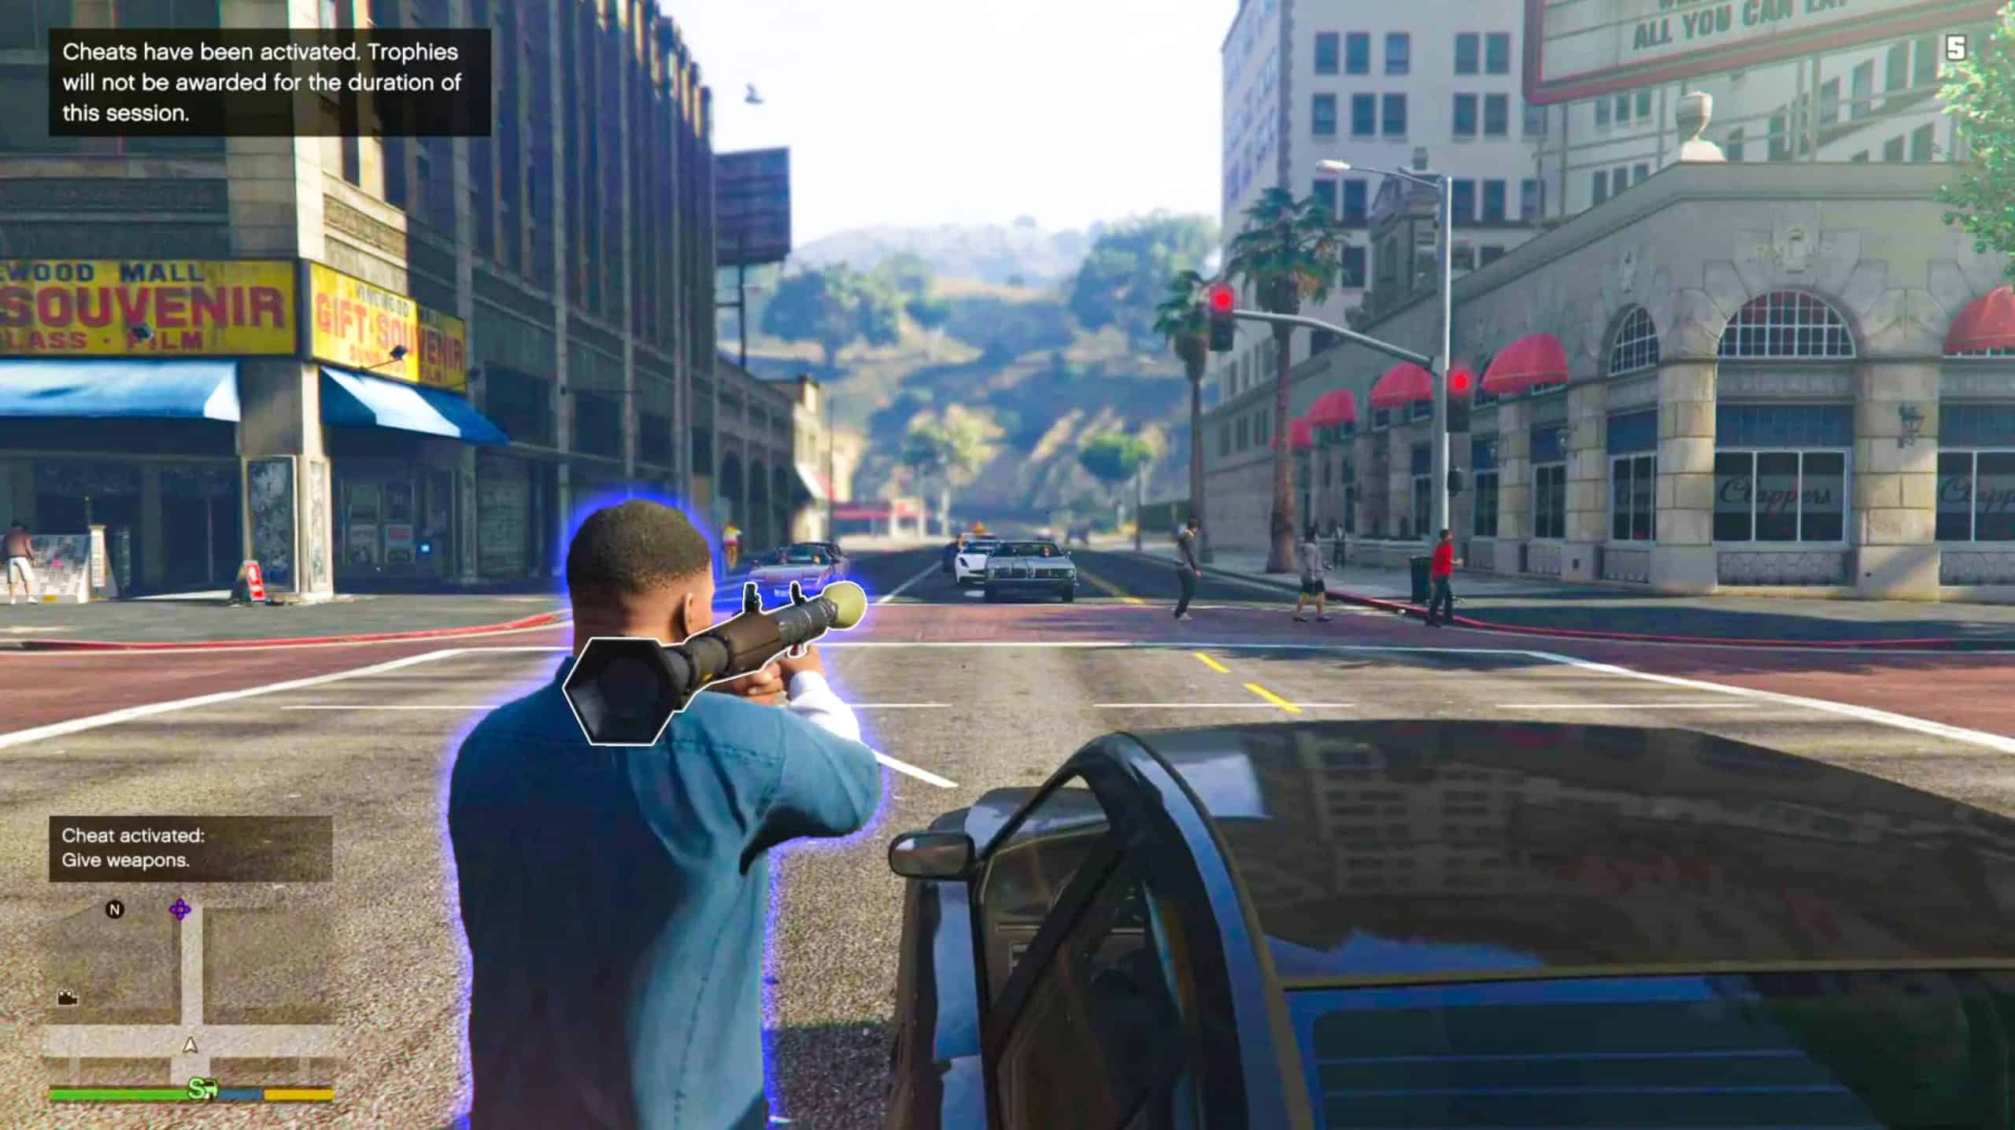
Grand Theft Auto

Slide 9
User Interaction and Function Calls
public function findLeaf() :void {
// Move the ant towards the leaf.
velocity = new Vector3D(Game.instance.leaf.x - position.x, Game.instance.leaf.y - position.y);
if (distance(Game.instance.leaf, this) <= 10) {
// The ant is extremelly close to the leaf, it's time
// to go home.
brain.setState(goHome);
}
if (distance(Game.mouse, this) <= MOUSE_THREAT_RADIUS) {
// Mouse cursor is threatening us. Let's run away!
// It will make the brain start calling runAway() from
// now on.
brain.setState(runAway);
}
}

Slide 10
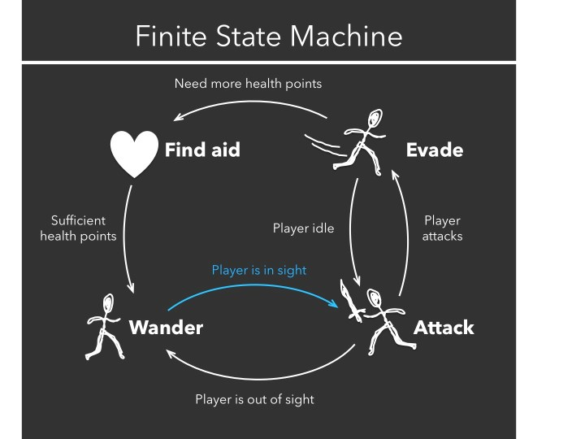
Finite-State Machine Algorithm
“Brain of a computer NPC”
1 Active State
Simple to Code
Set to Update every Frame
Notes:
A finite-state machine is a model used to represent and control execution flow. computation based on a hypothetical machine made of one or more states. Only a single state can be active at the same time, so the machine must transition from one state to another in order to perform different actions.

Slide 11
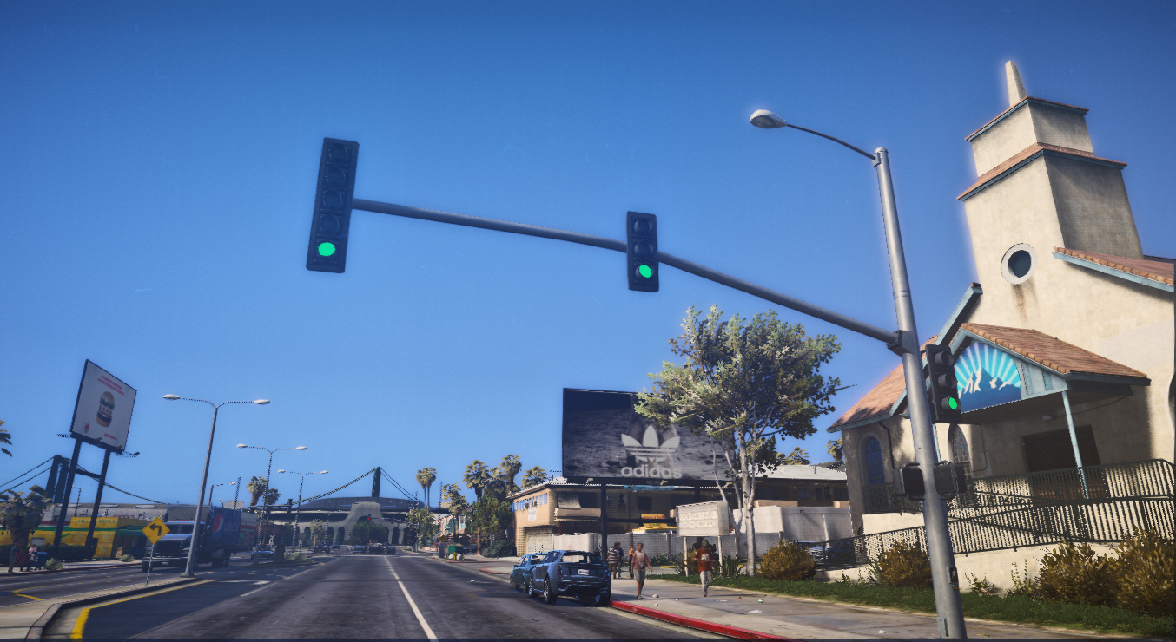
Traffic Lights

Slide 12
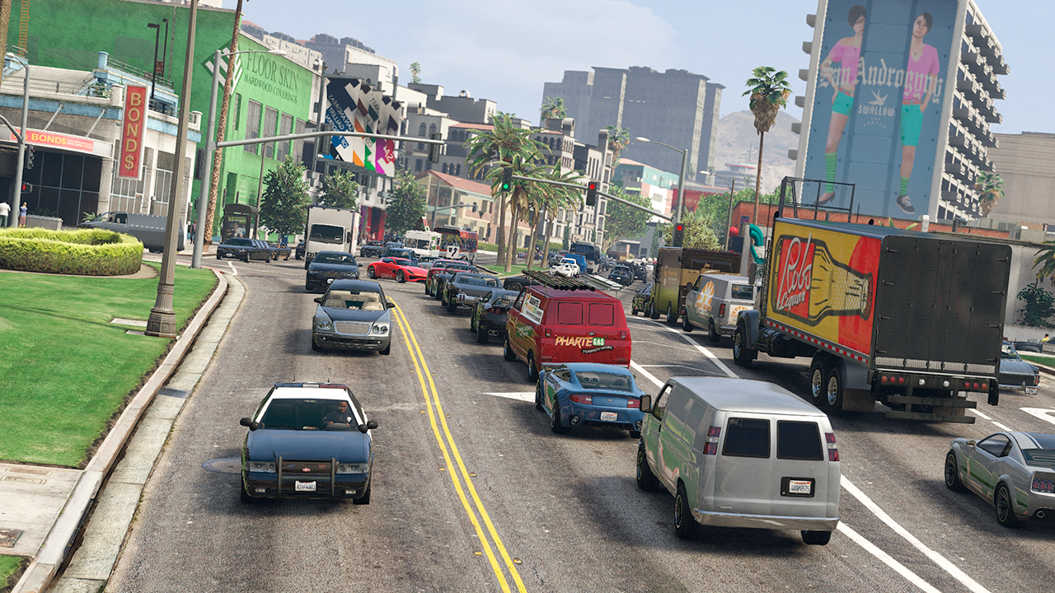
Cont
Autonomous Cars

Slide 13
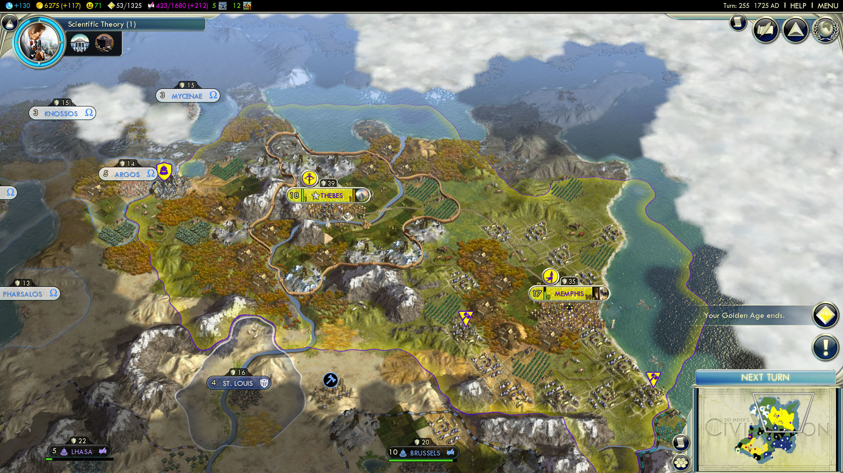
Civilization 5

Slide 14
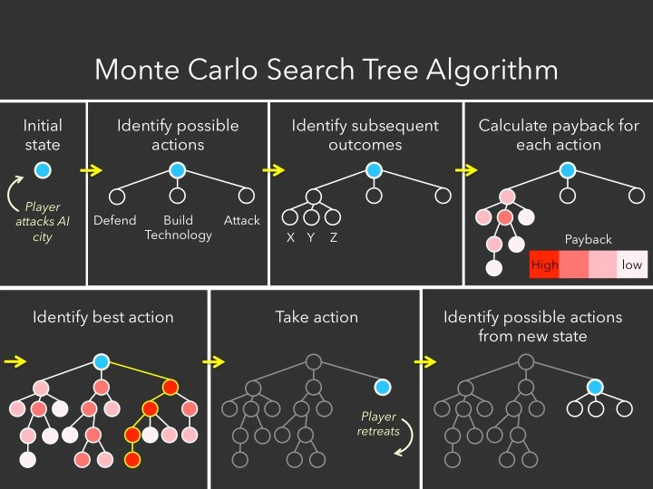
Strategy Games
Notes:
Strategy Games would be the simplest to explain,
For example, in Civilization, a game in which players compete to develop a city in competition with an AI who is doing the same thing, it is impossible to pre-program every move for the AI. Instead of taking action only based on current status as with FSM, a MCST AI evaluates some of the possible next moves, such as developing ‘technology’, attacking a human player, defending a fortress, and so on.

Slide 15
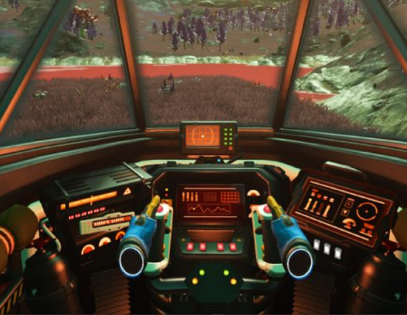
Future of Intelligent Systems in Gaming

Slide 16
Sources Cited
https://www.unr.edu/cse/undergraduates/prospective-students/what-are-intelligent-systems
https://whatis.techtarget.com/definition/intelligent-system/
https://techcrunch.com/2015/10/31/the-history-of-gaming-an-evolving-community/
https://en.wikipedia.org/wiki/Monte_Carlo_tree_search/
https://sitn.hms.harvard.edu/flash/2017/ai-video-games-toward-intelligent-game/
https://en.wikipedia.org/wiki/Artificial_intelligence_in_video_games

